Slide 1

CUSTOMER PREDICTIONS
Rounak Saha
28/01/2025

Slide 2
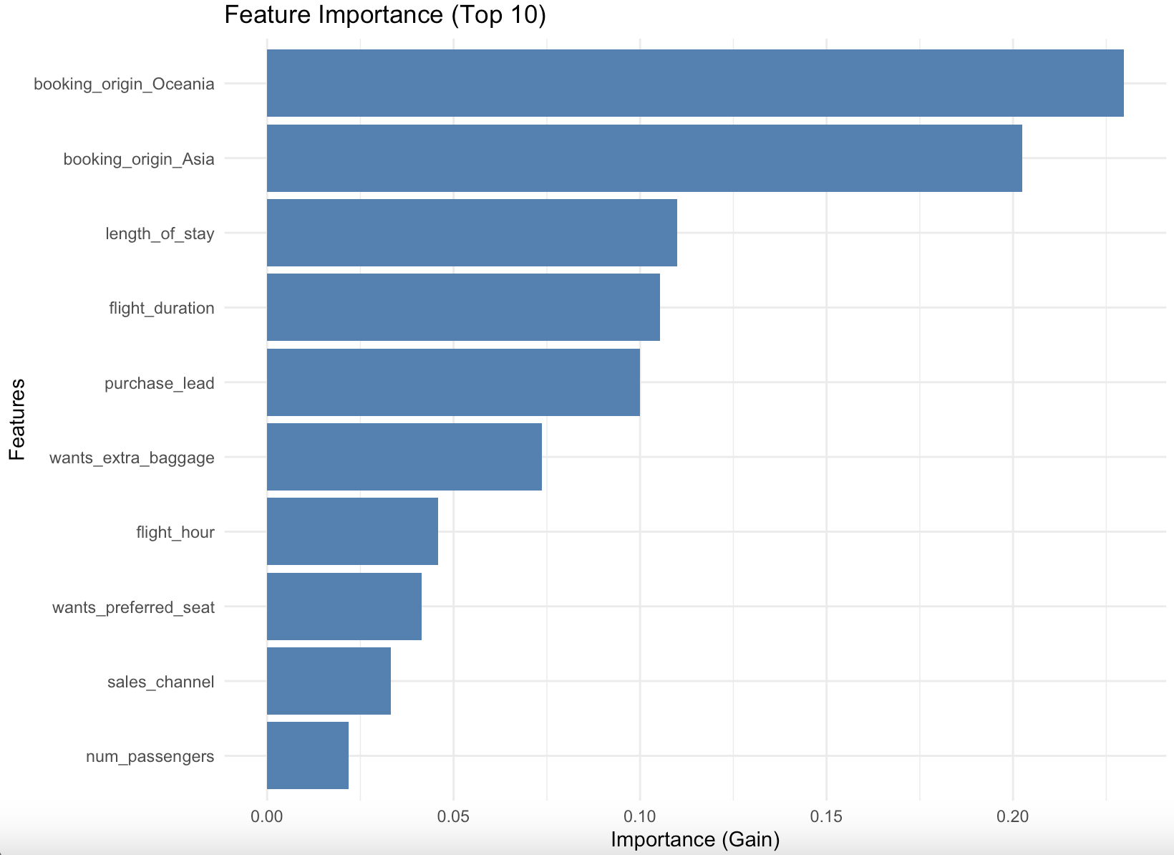
RESULTS
Evaluation
• The top 5 important variable in the model was booking_origin_Oceania, booking_origin_Asia, length_of_stay, flight_duration, purchase_lead
• Information about the sales channel , number of passengers was not important.
• The accuracy of the model was approximately 0.85 (Precision) and 0.03 (Recall), showing that this model requires more improvement. I suggest adding more customer-centric features into the model.

